Slide 1

Is toigh leam a bhith ag ionnsachadh a-muigh.
Notes:
I like to be learning outside.

Slide 2
Is toigh leam a bhith a’ peantadh le poll.
Notes:
I like to be painting with mud.

Slide 3

Is toigh leam a bhith a’ cunntadh le clachan.
Notes:
I like to be counting with stones.

Slide 4
Is toigh leam a bhith a’ sreap chraobhan.
Notes:
I like to be climbing trees.

Slide 5
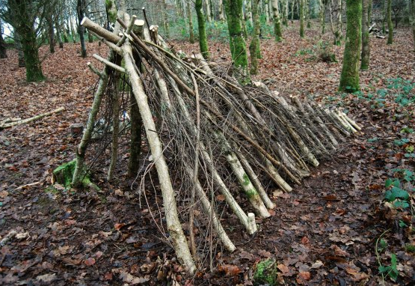
Is toigh leam a bhith a’ togail bothag.
Notes:
I like to be building a den.

Slide 6
Is toigh leam a bhith a’ dol tarsainn air sruthan.
Notes:
I like to be crossing a stream.

Slide 7
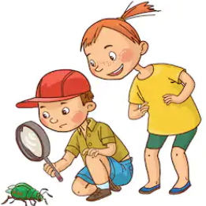
Is toigh leam a bhith a' sireadh bhiastagan.
Notes:
I like to be searching for insects.

Slide 8
Is toigh leam a bhith a' biadhadh nan eun.
Notes:
I like to be feeding the birds.

Slide 9
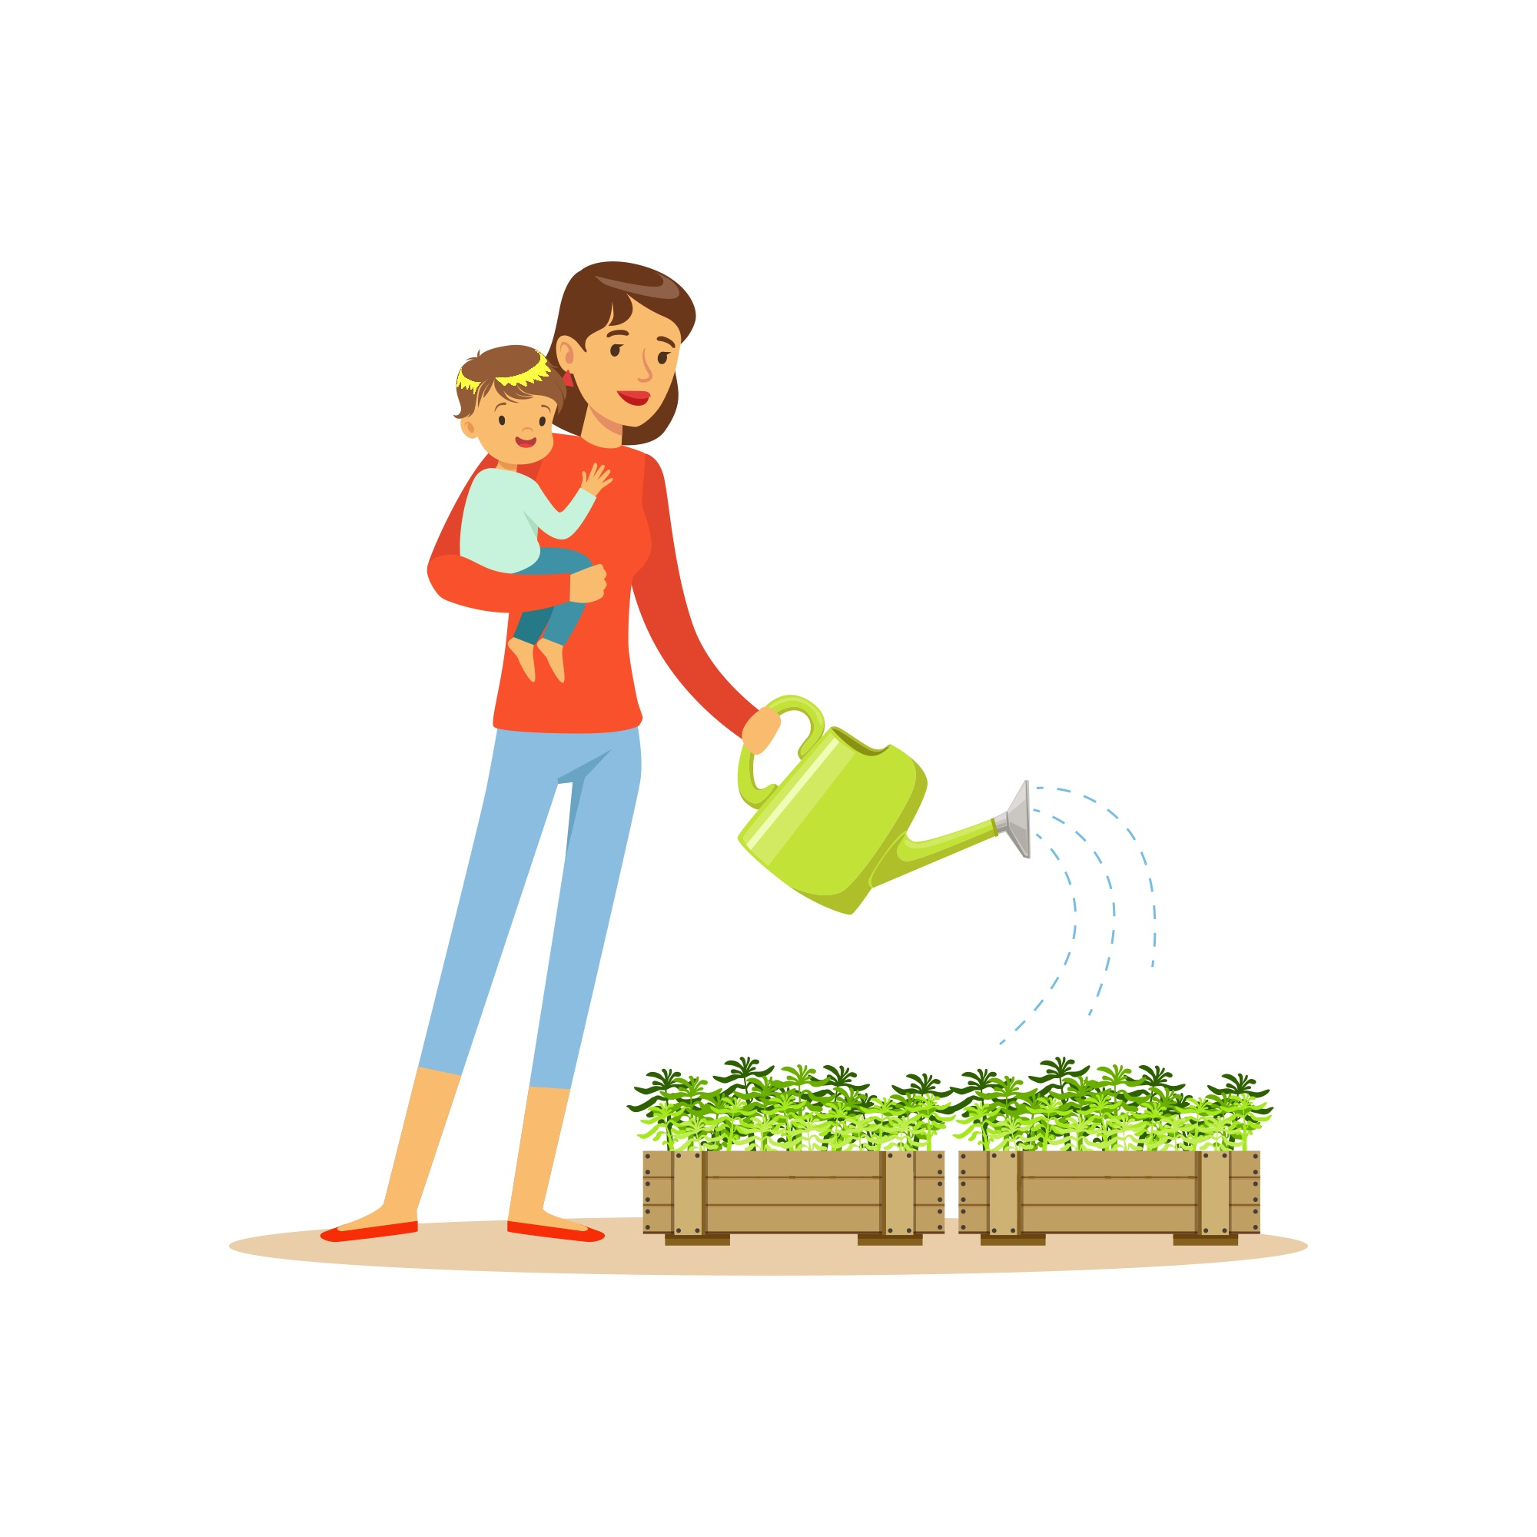
Is toigh leam a bhith a’ biathadh lusan.
Notes:
I like to be watering plants.

Slide 10
Is toigh leam a bhith a' cur lusan agus sìol.
Notes:
I like to be planting plants and seeds.

Slide 11
Dè ’s toigh leatsa a bhith a’ dèanamh nuair a bhios tu ag ionnsachadh a-muigh?
Notes:
What do YOU like to be doing when you are learning outside?

